Slide 1
Database Systems Laboratory 9
Introduction to PL/SQL
Rahul Kumar Mandal
School of Computer Engineering
KIIT Deemed to be University Bhubaneswar, Odisha, India

Slide 2
Introduction To PL/SQL
PL/SQL Basics
Conditional Logic
Looping Structure
Scope of variable in nested block
DEFINE Statemen

Slide 3
PL/SQL Basics
It is the procedural language extension of SQL
It is a block - structured language that enables developers
to combine the power of SQL with procedural statements
It bridges the gap between database technology and procedural programming languages
PL/SQL also possesses features of object oriented languages like: Data encapsulation, Error handling, Data hiding and Object oriented programming

Slide 4
Advantages of PL/SQL
It not only supports SQL data manipulation, but also provides facilities of conditional checking, branching & looping
It sends an entire block of statements to the oracle engine at one time. Thus, reduces network traffic
Permits dealing with errors
It allows declaration & use of variables in blocks of code
Applications written in PL/SQL are portable to any computer hardware and operating system

Slide 5
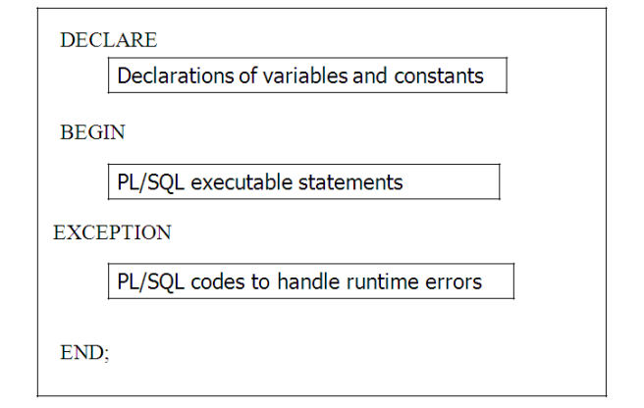
Structure of PL/SQL Block
DECLARE: declaration and initialization of variables and constants
BEGIN: implementation of actual programming logic
EXCEPTION: deals with runtime errors
END: end of PL/SQL block

Slide 6
Character Sets, Comments, Special operators
Character Sets
Letters: A...Z, and a...z
Numbers: 0...9
Symbols: ∼ ! @ # $ % ∧ & * ( ) - + { [ } ] | : ; « , > . ? / etc
Comments
Single line: - -
Multi line: /* ... */
Special operators
Assignment operator: : =
Comparison operator: =
Concatenation symbol: ||
Exponents: **

Slide 7
Variables, Constant, BOOLEAN Datatype, %TYPE
Variables
Variable name must begin with a character. Variable can hold at most 30 characters
Varname datatype[size];
Ex:Input_no NUMBER(3);
Constant
Varname CONSTANT datatype[size]:=value;
Ex: Input_no NUMBER(3) :=16;
Ex: Input_no CONSTANT NUMBER(3) :=16;
BOOLEAN Datatype
Logical data type, either TRUE or FALSE or NULL only
%TYPE
Describes the data type of the table column
identifier tablename.columnname%TYPE;
Ex: name Employee.empname%TYPE;

Slide 8
User Message
Oracle has a built-in package called DBMS_OUTPUT with the
procedure PUT_LINE to print
DBMS_OUTPUT.PUT_LINE (message);
Message is generally of varchar
Before using PUT_LINE(), you should switch ON the output
buffer as:
SET SERVEROUTPUT ON;

Slide 9
Conditional Logic
Simple IF
IF condition THEN
Statements
END IF;
Simple IF-ELSE
IF condition THEN
Statements
ELSE
Statements
END IF;
IF-ELSE Ladder
IF condition THEN
Statements
ELSIF condition THEN
Statements
ELSE
Statements
END IF;
Nested IF-ELSE
IF condition THEN
IF condition THEN
Statements
END IF
ELSE
State

Slide 10
Conditional Logic...
Input a number and check whether it is even or odd
DECLARE
n number(5);
BEGIN
n: =&n;
IF(MOD (n,2)=0) THEN
DBMS_OUTPUT.PUT_LINE(’even’);
ELSE
DBMS_OUTPUT.PUT_LINE(’odd’);
END IF;
END;

Slide 11
Conditional Logic...
Write a PL/SQL block that will accept a client_no from the user and adds 500 rupees to the bal_due column if the bal_due column has a value less than 5000 rupees. The process is fired on the Client_Master table.
DECLARE
bal Client_Master.bal_due%TYPE;
cno Client_Master.client_no%TYPE;
addn number(4): =500;
BEGIN
cno: =&cno;
SELECT bal_due INTO bal FROM Client_Master WHERE client_no=cno;
IF bal<5000 THEN
UPDATE Client_Master SET bal_due=bal_due+addn WHERE client_no=cno;
END IF;
END;

Slide 12
CASE Statement
CASE selector
WHEN exp1 THEN Statement1
WHEN exp2 THEN Statement2
...
WHEN expn THEN Statementn
ELSE Statementn+1
END CASE;

Slide 13
CASE Statement...
Input a 1-digit number and display the name
DECLARE
vdigit NUMBER(1);
BEGIN
vdigit: =&vdigit;
CASE vdigit
WHEN 0 THEN DBMS_OUTPUT.PUT_LINE (’ZERO’);
WHEN 1 THEN DBMS_OUTPUT.PUT_LINE (’ONE’);
WHEN 2 THEN DBMS_OUTPUT.PUT_LINE (’TWO’);
WHEN 3 THEN DBMS_OUTPUT.PUT_LINE (’THREE’);
WHEN 4 THEN DBMS_OUTPUT.PUT_LINE (’FOUR’);
WHEN 5 THEN DBMS_OUTPUT.PUT_LINE (’FIVE’);
WHEN 6 THEN DBMS_OUTPUT.PUT_LINE (’SIX’);
WHEN 7 THEN DBMS_OUTPUT.PUT_LINE (’SEVEN’);
WHEN 8 THEN DBMS_OUTPUT.PUT_LINE (’EIGHT’);
WHEN 9 THEN DBMS_OUTPUT.PUT_LINE (’NINE’);
ELSE DBMS_OUTPUT.PUT_LINE (vdigit||’ is wrong input’);
END CASE;
END;

Slide 14
Looping Structure
Basic Loop/Simple LOOP
LOOP
Statements
END LOOP;
The EXIT statement provides a way to stop the iterative loop:
• EXIT WHEN i>10;
• IF i>10 THEN EXIT;
END IF;
WHILE LOOP
WHILE condition
LOOP
Statements
END LOOP;
FOR LOOP
FOR variable IN [REVERSE] low.. high
LOOP
Statements
END LOOP;

Slide 15
Looping Structure
DECLARE
v_counter NUMBER := 1;
BEGIN
-- SIMPLE LOOP
DBMS_OUTPUT.PUT_LINE('Using SIMPLE LOOP:');
LOOP
DBMS_OUTPUT.PUT_LINE(v_counter);
v_counter := v_counter + 1;
-- Exit condition
EXIT WHEN v_counter > 10;
END LOOP;
-- WHILE LOOP
DBMS_OUTPUT.PUT_LINE('Using WHILE LOOP:');
v_counter := 1; -- Reset counter
WHILE v_counter <= 10 LOOP
DBMS_OUTPUT.PUT_LINE(v_counter);
v_counter := v_counter + 1;
END LOOP;
END;
-- FOR LOOP
DBMS_OUTPUT.PUT_LINE('Using FOR LOOP:');
FOR i IN 1..10 LOOP
DBMS_OUTPUT.PUT_LINE(i);
END LOOP;

Slide 16
Scope of variable in nested block
PL/SQL statements can be nested wherever an executable statement is allowed. A nested block acts like a statement and executable statements can be broken into smaller blocks
DECLARE
VA NUMBER(4): =10;
VB NUMBER(4): =11;
BEGIN
DECLARE
VA NUMBER(4): =100;
VB NUMBER(4): = 111;
BEGIN
DBMS_OUTPUT.PUT_LINE(VA);
DBMS_OUTPUT.PUT_LINE(VB);
END;
DBMS_OUTPUT.PUT_LINE(’..................’);
DBMS_OUTPUT.PUT_LINE(VA);
DBMS_OUTPUT.PUT_LINE(VB);
END;

Slide 17
DEFINE Statement
It is used to enter different sets of values by using & symbol on substitution variables
It is done by setting the DEFINE ON and OFF
At the entry of each value, execute:
SET DEFINE OFF;
Later execute:
SET DEFINE ON;
SELECT * FROM employees WHERE department_id = &dept_id;

